Slide 1

UE23CS320B – Capstone Project Phase – 2
Project Progress Review #1
Project Title : Toward Trustworthy Stock Prediction : A Self-Aware Multimodal Quant AI Framework
Project ID : PW26_MG_02
Project Guide : Prof. Mahitha G
Project Team :
ADISHREE GUPTA | PES1UG23CS024
AKSHAT | PES1UG23CS048
BHAVANI S | PES1UG23CS144
BHUMIKA S LOKARE | PES1UG24CS803
Adishree Gupta_Bhumika Lokare_Bhavani S_Akshat

Slide 2
Toward Trustworthy Stock Prediction : A Self-Aware Multimodal Quant AI Framework
Outline
Abstract and scope.
Suggestions from phase-1
Literature survey
Design Approach
Design constraints, Assumptions and Dependencies
Proposed methodology/Approach
Architecture
Project Progress Plan for Phase 2
References
Any other Information
Adishree Gupta_Bhumika Lokare_Bhavani S_Akshat

Slide 3
Toward Trustworthy Stock Prediction : A Self-Aware Multimodal Quant AI Framework
Problem Statement
Building Trustworthy Stock Prediction: From Problem to Self-Aware AI Solution
“Traditional quantitative models and modern AI for Financial Securities prediction are often rigid, opaque, and unaccountable. This project addresses these limitations by developing a self-aware, multimodal AI framework that dynamically adapts to real-time markets, provides explainable predictions, and ensures verifiable accountability through transparent data logging.”
The Opportunity: Develop a trustworthy, explainable prediction platform that addresses these critical pain points.
Adishree Gupta_Bhumika Lokare_Bhavani S_Akshat

Slide 4
Toward Trustworthy Stock Prediction : A Self-Aware Multimodal Quant AI Framework
Abstract and Scope
Our Model Adapts in Real Time
Our Model Explains Every Prediction
Traditional models like CAPM fail in today’s volatile, fast-paced markets due to rigid assumptions and static risk-return frameworks. To address this, we’re building adaptive, data-driven models that dynamically recalibrate to real-time market signals and structural shifts.
Current AI models, while powerful, act as opaque "black boxes," obscuring their decision logic and risking hallucinations and eroded trust. To solve this, we’re developing interpretable architectures that provide clear, auditable reasoning behind every prediction.
Our Model Delivers Clean, Verified, Context-Aware Insights
Our Model Logs Every Step for Full Accountability
Investors struggle with misinformation and opaque financial data, undermining their ability to make sound decisions. We address this by delivering verified, transparent data streams with clear provenance and real-time contextual insights.
Regulators need clear, verifiable records to protect market integrity and stop manipulation—but current systems often can’t provide reliable audit trails. We solve this by building transparent, tamper-proof data systems that log every change for full accountability.
The Opportunity: Develop a trustworthy, explainable prediction platform that addresses these critical pain points.
Adishree Gupta_Bhumika Lokare_Bhavani S_Akshat

Slide 5
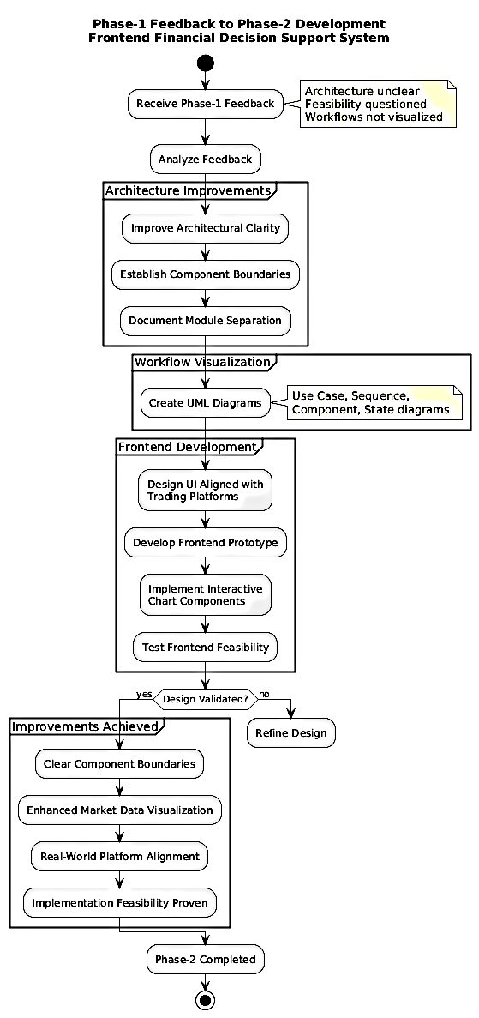

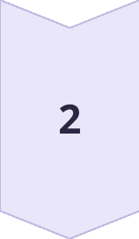
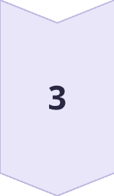
Toward Trustworthy Stock Prediction : A Self-Aware Multimodal Quant AI Framework
Suggestions from Phase1
Feedback Received
Enhance architectural clarity
Demonstrate implementation feasibility
Improve module separation
Actions Implemented
User interface designed to reflect real-world trading systems
Core user workflows visualized through UML diagrams
Frontend prototype developed to validate system feasibility
Improvements Achieved
Clear component boundaries
Enhanced visualization of market data using interactive charts and indicators
Better alignment of system design with real-world trading platforms
Adishree Gupta_Bhumika Lokare_Bhavani S_Akshat

Slide 6
Toward Trustworthy Stock Prediction : A Self-Aware Multimodal Quant AI Framework
Literature Survey
Paper Details | Aim of the paper ( In One Line) | Method | Limitations of the paper | Relation to Project Hypothesis
FinRL: Adaptive Model Selection for Reinforcement Learning in Stock Trading Link: https://ieeexplore.ieee.org/document/11038809 Year 2025 | Create market-adaptive trading system selecting models based on bull/bear market trends. | FinRL-DeepSeek using dynamic RL agents and LLM sentiment for market-specific trading | High computational costs, latency in switching, and dependency on real-time news data. | Supports — Demonstrates adaptive model selection aligned with dynamic, explainable decision systems
A Novel RMS-Driven Deep Reinforcement Learning for Optimized Portfolio Management in Stock Trading Link: https://ieeexplore.ieee.org/document/10904473 Year 2025 | Optimize portfolio management using multi-source signals and risk-aware reward functions | A2C, DDPG, and PPO agents using historical data, technical indicators, and sentiment. | Limited market testing, lacks real-time validation, and relies on daily data. | Supports — Shows adaptability and risk-awareness but limited explainability
Magic Net: Memory-Aware Graph Interactive Causal Network for Multivariate Stock Price Movement Prediction Link: https://ieeexplore.ieee.org/document/10834555 +A5Year 2025 | Predict multivariate movements using causal correlations and temporal text memory. | Graph interactive causal network incorporating text memory and hierarchical dependencies | High computational complexity and scalability issues with large numbers of stocks. | Strongly Supports — Introduces causal reasoning and interpretability beyond black-box prediction
Stock Market Analysis and Price Prediction Link: https://ieeexplore.ieee.org/document/11031782 Year 2025 | Enhance forecasting accuracy by integrating fundamental, technical, and deep learning methods. | Hybrid framework combining Logistic Regression, KNN, and LSTM for layered predictions | High training complexity and significant dependency on data quality and tuning. | Alternative Hypothesis — Focuses on accuracy-driven hybrid models with limited explainability
Portfolio Research Based on LSTM Model Link: https://ieeexplore.ieee.org/document/11075488 Year 2025 | Predict CSI 300 prices and construct portfolios using LSTM neural networks. | LSTM neural network trained on historical price data for top index constituents. | Restricted scope to top 10 stocks and lacks external sentiment factors. | Alternative Hypothesis — Emphasizes predictive performance over transparency and uncertainty handling
Overall, the literature indicates that while accuracy-driven and hybrid prediction models perform well under stable conditions, adaptive and explainability-first approaches provide stronger robustness, trust, and decision reliability in volatile market environments, which directly motivates the proposed system.
Adishree Gupta_Bhumika Lokare_Bhavani S_Akshat

Slide 7
Toward Trustworthy Stock Prediction : A Self-Aware Multimodal Quant AI Framework
Challenges and Research Gaps
Lack of Real-Time Adaptability & Explainability
Most models are static or use simplistic dynamic triggers (e.g., bull/bear phases), failing to continuously recalibrate to live market signals. Furthermore, deep learning architectures (LSTM, GNNs, Transformers) act as "black boxes," offering no clear, auditable reasoning for their predictions, which erodes investor and regulatory trust.
Models often rely on aggregated or unverified data sources (e.g., public sentiment indices, generic news headlines) without ensuring data quality, timeliness, or provenance. They also struggle to provide the verified, real-time contextual insights that investors need to understand why a prediction was made, beyond just the output.
Insufficient Data Provenance & Contextual Insight
Current systems lack transparent, tamper-proof logging mechanisms. There is no reliable way to track every data input, model parameter change, or decision-making step, making it impossible to meet regulatory requirements for accountability and prevent market manipulation, which is critical for building a truly trustworthy platform.
Inadequate Accountability
&Audit Trails
Adishree Gupta_Bhumika Lokare_Bhavani S_Akshat

Slide 8
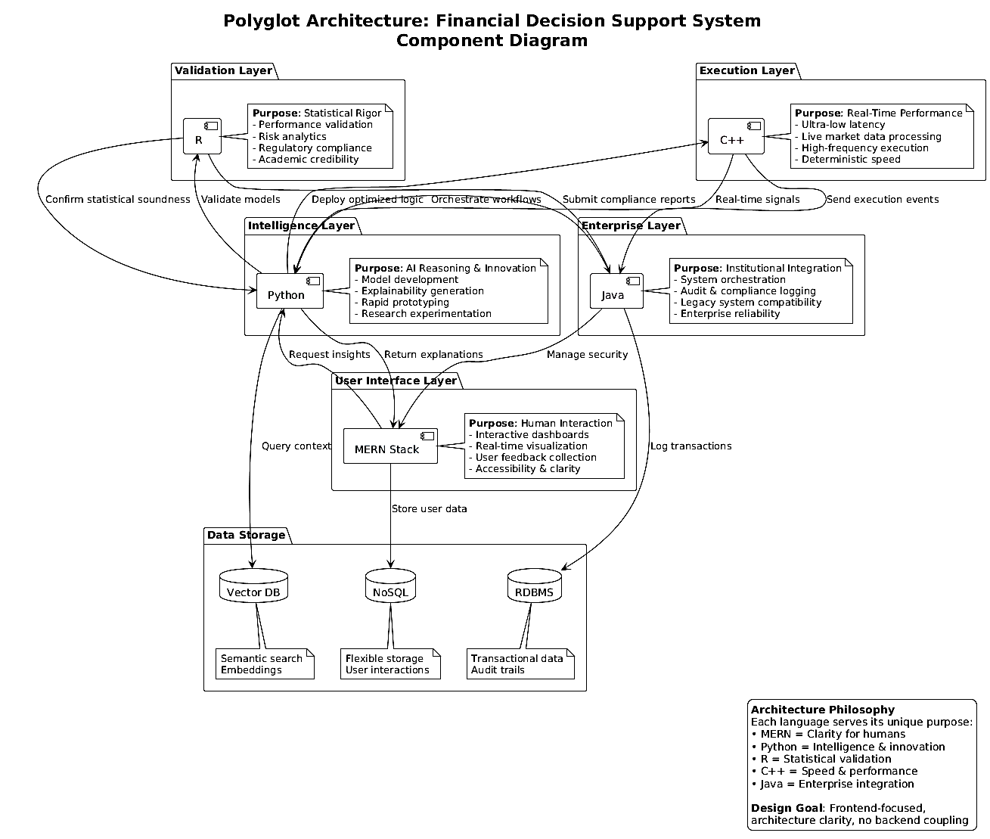
Toward Trustworthy Stock Prediction : A Self-Aware Multimodal Quant AI Framework
Design Approach
Adishree Gupta_Bhumika Lokare_Bhavani S_Akshat

Slide 9
Toward Trustworthy Stock Prediction : A Self-Aware Multimodal Quant AI Framework
Design Approach
Design Approach Followed
We followed a frontend-first, modular polyglot design approach.
The system is designed as logically independent components
Each component is planned to use the most suitable technology for its role
User interaction and visualization are prioritized in the current phase
UML diagrams are used to formally capture system structure and flow
The approach emphasizes clear separation of concerns rather than early integration.
Why this approach was chosen
Financial decision systems involve diverse responsibilities such as visualization, analytics, and explanation
A single monolithic design limits flexibility and clarity
A frontend-first approach helps validate feasibility early
Modular design reduces coupling and improves understandability
Polyglot architecture allows future scalability without redesign
Benefits
Clear component boundaries improve architectural clarity
Easier understanding and validation of system flow
Technology flexibility for different system responsibilities
Independent development and testing of modules
Better alignment with real-world financial platforms
Drawbacks
Higher architectural complexity compared to monolithic designs
Requires careful definition of interfaces between components
Integration effort is deferred to later phases
These drawbacks are acceptable at this stage since the focus is on design validation and feasibility.
Adishree Gupta_Bhumika Lokare_Bhavani S_Akshat

Slide 10
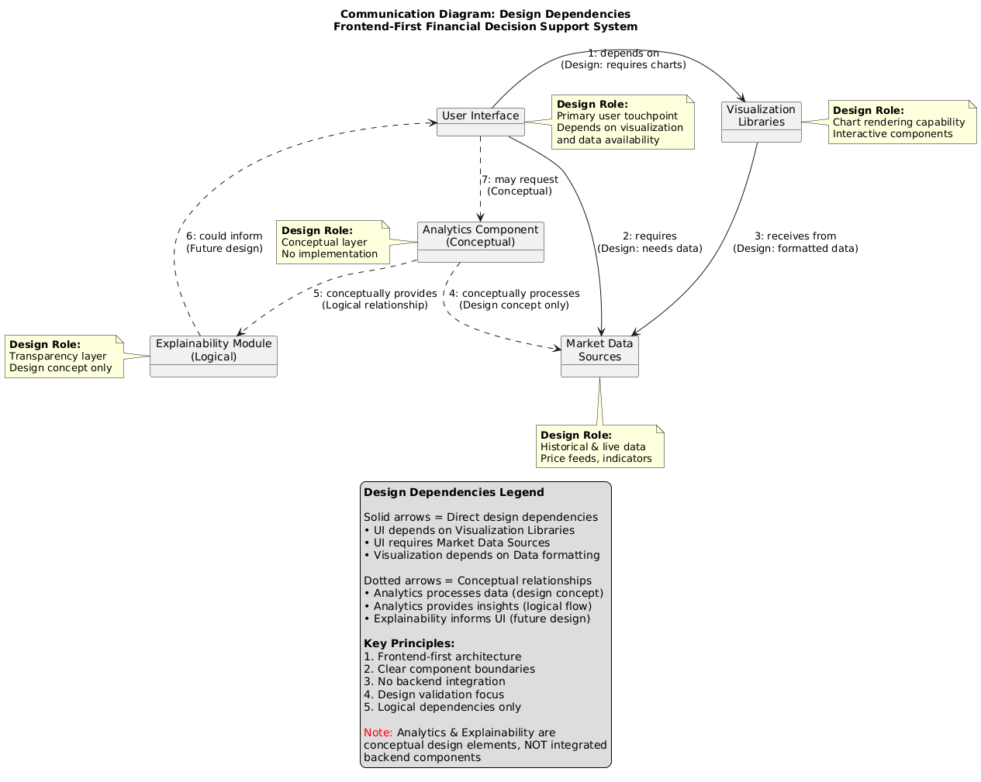
Toward Trustworthy Stock Prediction : A Self-Aware Multimodal Quant AI Framework
Design Constraints, Assumptions & Dependencies
Design Constraints
• Academic time constraints limited full end-to-end integration
• No access to live trading or real-money execution environments
• System required to remain explainability-focused rather than accuracy-focused
• Design needed to support multiple technologies without tight coupling
Design Dependencies
• Availability of historical market data for visualization
• Visualization and charting libraries for frontend rendering
• Well-defined interfaces between logical system components
• UML modeling tools for design validation
Impact on the Project
• Enables early validation of user workflows
• Reduces risk of architectural rework in later phases
• Allows independent evolution of system components
• Shifts integration effort to subsequent phases
Design Assumptions
• Users benefit more from transparent visual explanations than raw predictions
• Historical market data is sufficient for demonstrating feasibility
• Clear separation of system components improves understandability
• Integration can be safely deferred if system flow is well-defined
Adishree Gupta_Bhumika Lokare_Bhavani S_Akshat

Slide 11
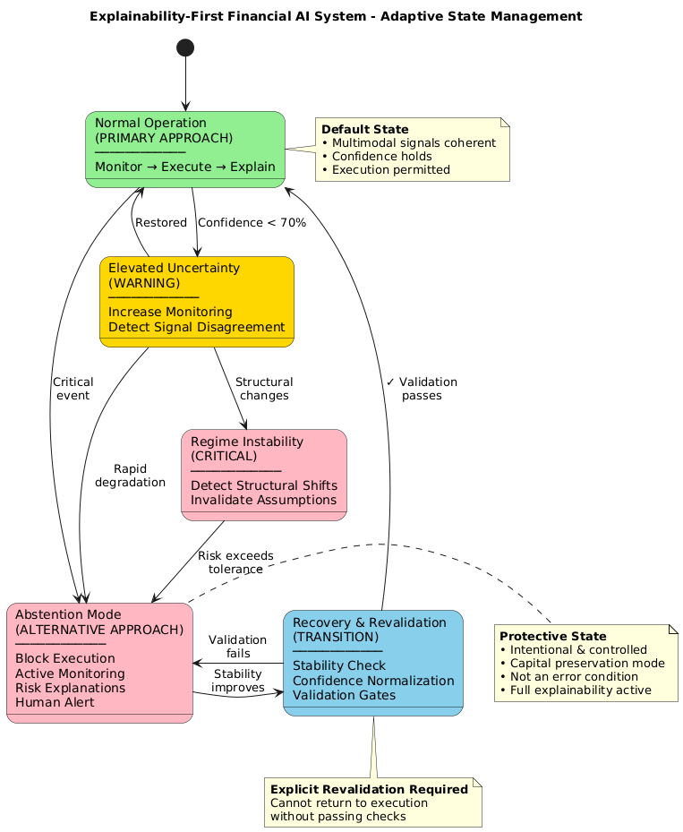
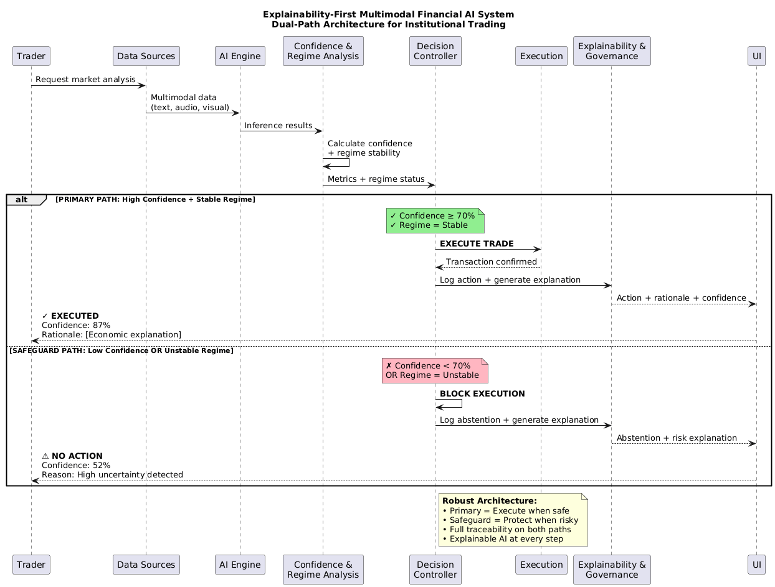
Toward Trustworthy Stock Prediction : A Self-Aware Multimodal Quant AI Framework
Proposed Methodology / Approach
Adishree Gupta_Bhumika Lokare_Bhavani S_Akshat

Slide 12
Toward Trustworthy Stock Prediction : A Self-Aware Multimodal Quant AI Framework
Proposed Methodology / Approach
Aspect | Primary Approach: Explainability-First Controlled Execution | Alternative Approach: Abstention-First Safeguard Mode
Core Philosophy | Execute actions only when confidence and regime stability are verified | Avoid execution under uncertainty and prioritize safety
Trigger Condition | Confidence ≥ threshold and stable regime | Confidence below threshold or regime instability
System Behavior | Monitor → Execute → Explain | Block execution → Monitor → Explain
Decision Strategy | Confidence-aware execution with continuous validation | Conservative abstention during high uncertainty
Risk Handling | Risk is managed through gradual state transitions (normal → warning → critical) | Risk is minimized by halting execution entirely
Explainability | Explanations generated alongside execution | Explanations generated to justify abstention
User Trust | High, due to transparent rationale and confidence reporting | High, due to explicit uncertainty disclosure
Human Involvement | Minimal during stable conditions | Increased human oversight during unstable conditions
Performance Orientation | Balanced focus on safety, interpretability, and execution | Strong focus on capital protection and control
Advantages | • Transparent decisions • Risk-aware execution • Audit-friendly design • Aligned with institutional trading practices | • Strong risk containment • Explicit uncertainty handling • Regulatory-friendly • Human-in-the-loop support
Limitations | • Conservative execution • Slightly higher system complexity • Not optimized for pure speed | • Missed opportunities possible • Lower automation level • Slower recovery to execution
Best Use Case | Stable market regimes with high confidence signals | Volatile or ambiguous market regimes
Design Intent | Controlled automation with explainability | Protective fallback ensuring system safety
Adishree Gupta_Bhumika Lokare_Bhavani S_Akshat

Slide 13
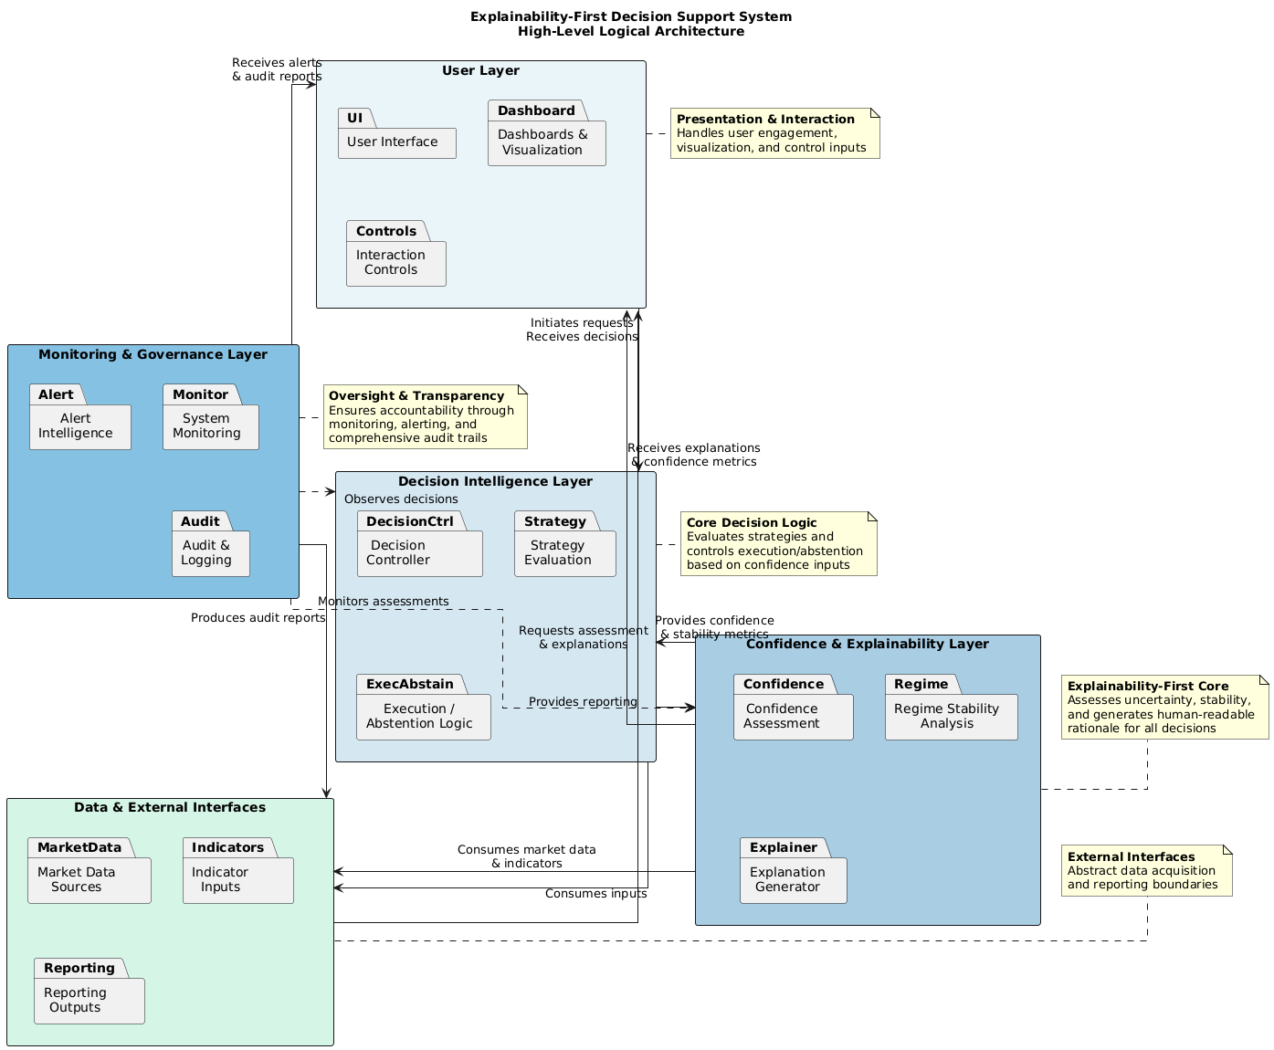
Toward Trustworthy Stock Prediction : A Self-Aware Multimodal Quant AI Framework
Architecture
System Architecture Layers
User Layer: Manages presentation and interaction by handling user engagement through the UI, dashboards for visualization, and interaction controls.
Decision Intelligence Layer: Serves as the core decision logic, evaluating strategies and controlling execution or abstention based on confidence inputs and controller logic.
Confidence & Explainability Layer: Acts as the "Explainability-First Core" by assessing uncertainty and regime stability to generate human-readable rationales for all decisions.
Monitoring & Governance Layer: Provides oversight and transparency through system monitoring, alert intelligence, and comprehensive audit trails to ensure accountability.
Data & External Interfaces Layer: Abstracts data acquisition and reporting boundaries by managing market data sources, indicator inputs, and reporting outputs.
Adishree Gupta_Bhumika Lokare_Bhavani S_Akshat

Slide 14
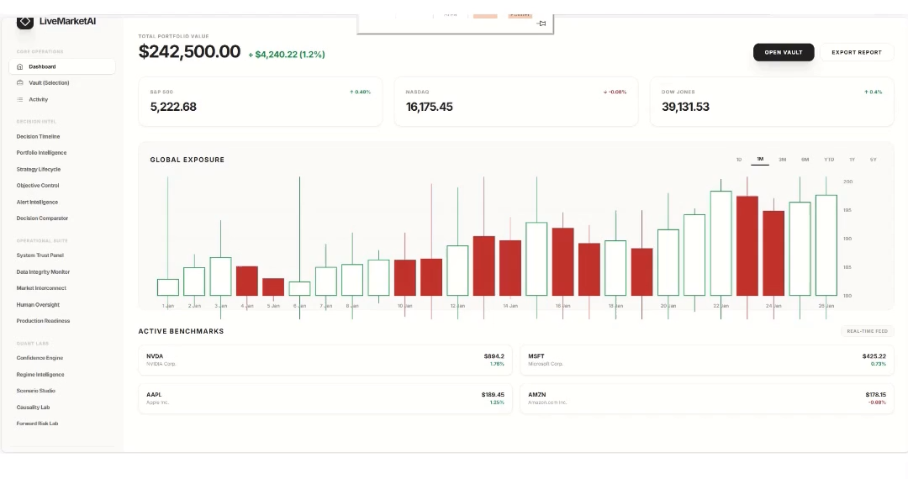
Toward Trustworthy Stock Prediction : A Self-Aware Multimodal Quant AI Framework
Progress Update
Adishree Gupta_Bhumika Lokare_Bhavani S_Akshat

Slide 15
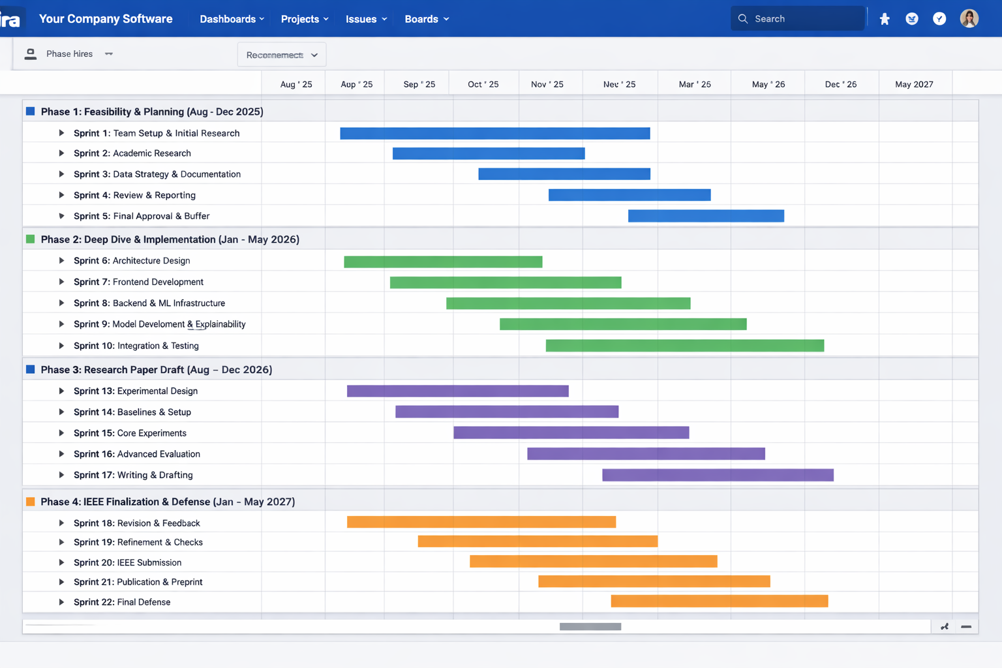
Toward Trustworthy Stock Prediction : A Self-Aware Multimodal Quant AI Framework
Project Progress Plan for Phase 2
Adishree Gupta_Bhumika Lokare_Bhavani S_Akshat

Slide 16
Toward Trustworthy Stock Prediction : A Self-Aware Multimodal Quant AI Framework
References
V. Kosidphokin, P. Loedtrakunchai, N. Sinamnuaiphon, and S. Kuptanon, “FinRL: Adaptive Model Selection for Reinforcement Learning in Stock Trading,” in Proc. 2025 IEEE 11th Int. Conf. Intelligent Data and Security (IDS), 2025.
A. Sattar, A. Sarwar, S. Gillani, M. Bukhari, S. Rho, and M. Faseeh, “A Novel RMS-Driven Deep Reinforcement Learning for Optimized Portfolio Management in Stock Trading,” IEEE Access, 2025.
D. Luo, S. Li, W. Liao, and R. Yan, “MagicNet: Memory-Aware Graph Interactive Causal Network for Multivariate Stock Price Movement Prediction,” IEEE Trans. Knowl. Data Eng., 2025.
R. S, S. V. N, G. Brindha, and M. V. Karthikeyan, “Stock Market Analysis and Price Prediction,” in Proc. 2025 Int. Conf. Frontier Technologies and Solutions (ICFTS), 2025.
Z. Zuo and F. Yang, “Portfolio Research Based on LSTM Model,” in Proc. 2025 16th Int. Conf. E-Education, E-Business, E-Management and E-Learning (IC4E), 2025.
A Sohan Avaneesh Guptha, Sri Surya Shobith Kamisetty, K Rupesh Venkata Sai Krishna, Bharathi Mohan G, Gundala Pallavi, Prasanna Kumar R, "Sector-Wise Portfolio Risk Assessment: Monte Carlo Simulation of NIFTY 50 Stocks," 2025 International Conference on Advanced Computing Technologies (ICoACT), 2025 .
Aparajita Biswal, Arunesh P. Singh, Homera Durani, Yashasvi Shah, "Intelligent stock price prediction: a data-driven forecasting system," Parul University International Conference on Engineering and Technology 2025 (PiCET 2025), 2025.
Kaikai Liu, Peize Lu, Hang Li, Lingrui Wang, "Regression Prediction of US Stock Prices Based on RBF Neural Network," 2025 IEEE International Conference on Electronics, Energy Systems and Power Engineering (EESPE), 2025
Adishree Gupta_Bhumika Lokare_Bhavani S_Akshat

Slide 17
Thank You
Adishree Gupta_Bhumika Lokare_Bhavani S_Akshat

